Slide 1
CSC373
Week 4

Slide 2
5 steps of Dynamic Programming
1. Optimal substructure definition
2. Memorization –
Define an appropriate array to store intermediate values
3. Rewrite the recurrence relation in terms of the array(s) defined in step 2
4. Bottom-up approach
5. Compute a path to an actual solution(not just value)

Slide 3
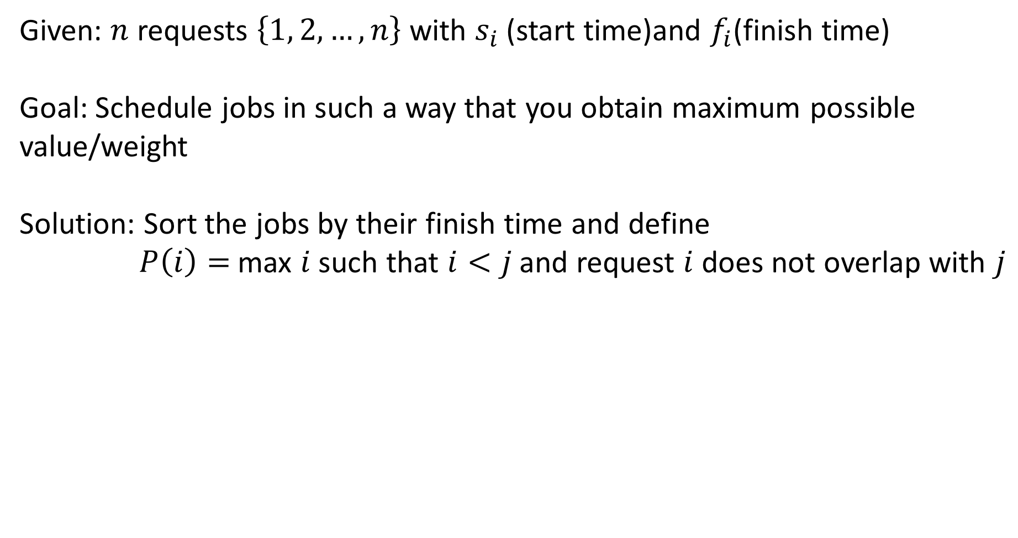
Example 1
Given: $n$ requests $\left\{1, 2, …, n\right\}$ with $s_{i}$ (start time)and $f_{i}$(finish time)
Goal: Schedule jobs in such a way that you obtain maximum possible value/weight
Solution: Sort the jobs by their finish time and define
$P\left(i\right)=$max $i$ such that $i<j$and request $i$ does not overlap with $j$

Slide 4
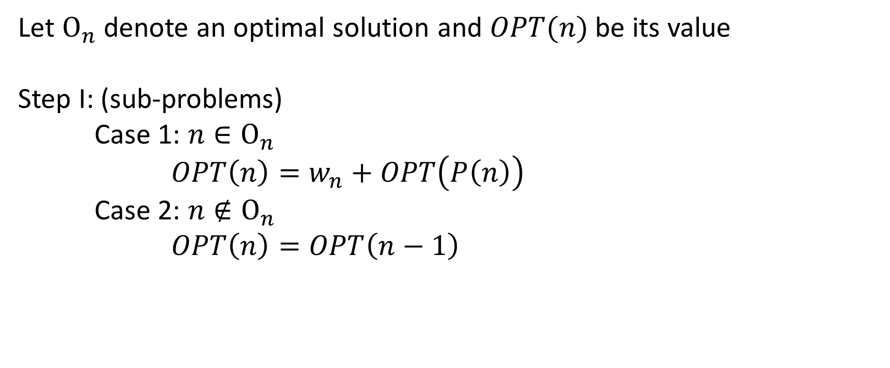
Example 1 (continued)
Let $Ο_{n}$ denote an optimal solution and $OPT(n)$ be its value
Step I: (sub-problems)
Case 1: $n∈Ο_{n}$
$OPT\left(n\right)=w_{n}+OPT\left(P\left(n\right)\right)$
Case 2: $n∉Ο_{n}$
$OPT\left(n\right)=OPT\left(n−1\right)$

Slide 5
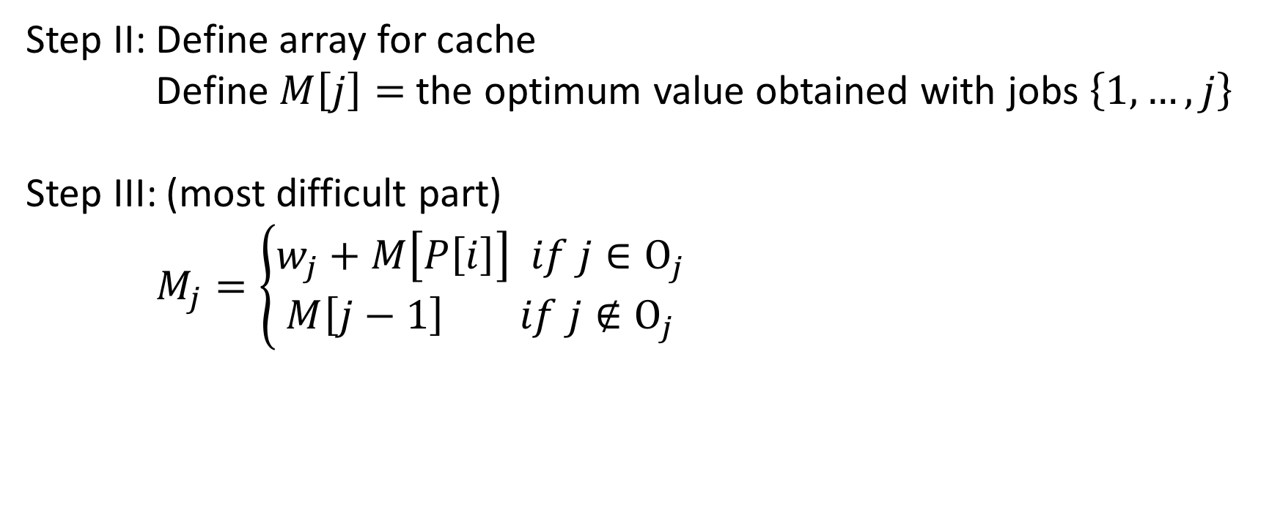
Example 1 (continued)
Step II: Define array for cache
Define $M\left[j\right]=$ the optimum value obtained with jobs $\left\{1, …,j\right\}$
Step III: (most difficult part)
$M_{j}=\left\{\begin{aligned}w_{j}+M\left[P\left[i\right]\right] if j∈Ο_{j} \\ M\left[j−1\right] if j∉Ο_{j}\end{aligned}\right.$

Slide 6
Example 1 (continued)
Step IV:
M_Compute_Opt(j):
If j = 0 then
return 0
If M[j] is defined, then
return M[j]
Else
M[j] = max(M_compute_Opt(j-1), w_{j}+ M_compute_Opt(P[j])
return M[j]
EndIf
M[n] is the final optimal value complexity: O(n)

Slide 7
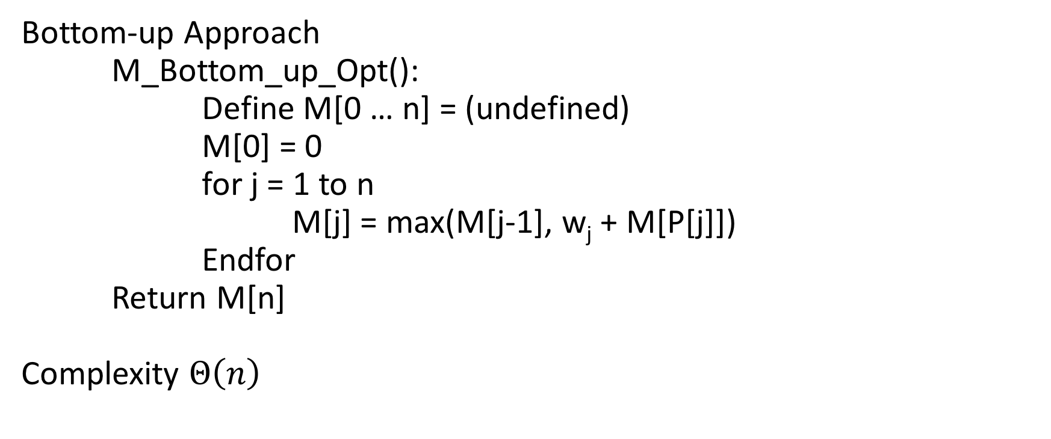
Example 1 (continued)
Bottom-up Approach
M_Bottom_up_Opt():
Define M[0 … n] = (undefined)
M[0] = 0
for j = 1 to n
M[j] = max(M[j-1], w_{j} + M[P[j]])
Endfor
Return M[n]
Complexity $Θ\left(n\right)$

Slide 8
Example 1 (continued)
Step V: Finding an optimal solution with the optimal value
M_compute_Path(j, M):
If j = 0:
return ” ”
Else
if w_{j}+M[P[j]] > M[j-1] then
output M_compute_math(P[j], M) + j
Else
output M_compute_path(j-1, M)
Endif
Endif

Slide 9
Example 1 (continued)
M_compute_Path_Iterative(n, M):
for j = n to 1;
if M[P[j]] + w_{j} > M[j-1]
output j + “ “
j = P[j]
Else
j = j – 1
EndIf
Endfor

Slide 10
Example 2: Rod Cutting Problem
P[i] = Price for rod of length i
Goal: Cut up the rod into pieces so that the sum of the price of the pieces is maximum

Slide 11
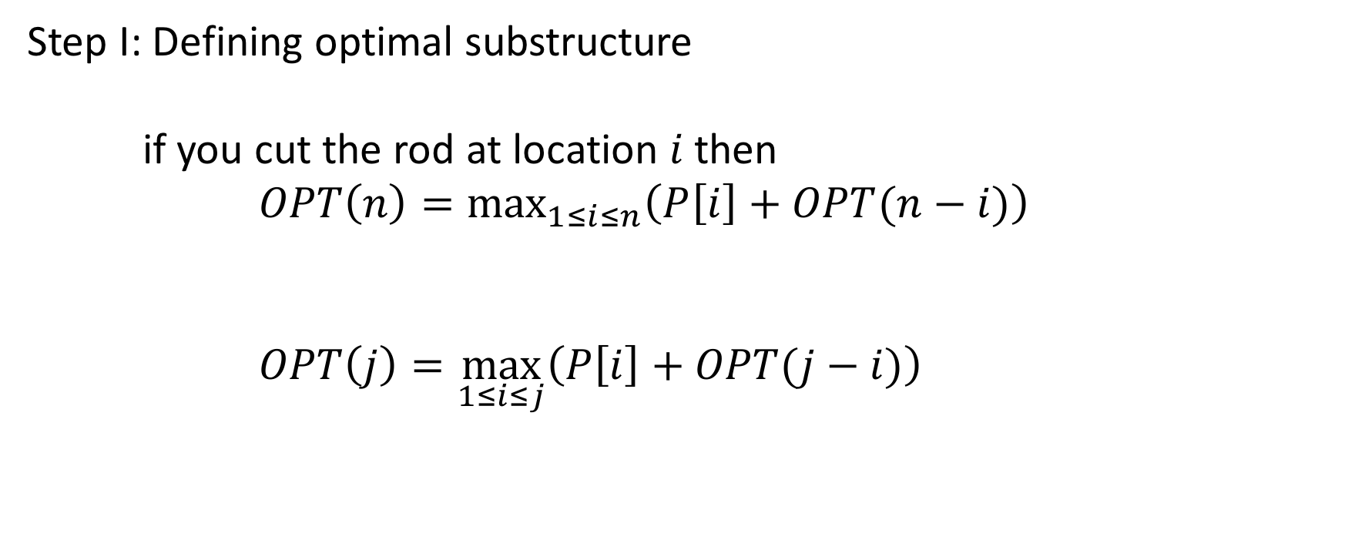
Example 2 (continued)
Step I: Defining optimal substructure
if you cut the rod at location $i$ then
$OPT\left(n\right)=\max_{1≤i≤n}\left(P\left[i\right]+OPT(n−i)\right)$
$OPT\left(j\right)=\max_{1≤i≤j}\left(P\left[i\right]+OPT(j−i)\right)$

Slide 12

Example 2 (continued)
Step II: Array definition
$M[j]$ = optimal value on a rod of length $j$
Step III:
$M\left[j\right]=\max_{1≤i≤j}\left(P\left[i\right]+M\left[j−1\right]\right)$

Slide 13

Example 2 (continued)
Step IV: Bottom-up Approach
Bottom_up_cut_Rod(P, n):
Define M[0, …, n], S[0, …, n]
M[0] = 0, S[0] = 0
for j=1 to n:
q = -$∞$
for i=1 to j:
if q < P[i] + M[j-i] then
q = p[j] + M[j-i]
s[j] = i
Endfor
Endfor
Return M and S
Complexity: 1+2+3+4+…+n = $Θ(n^{2})$

Slide 14
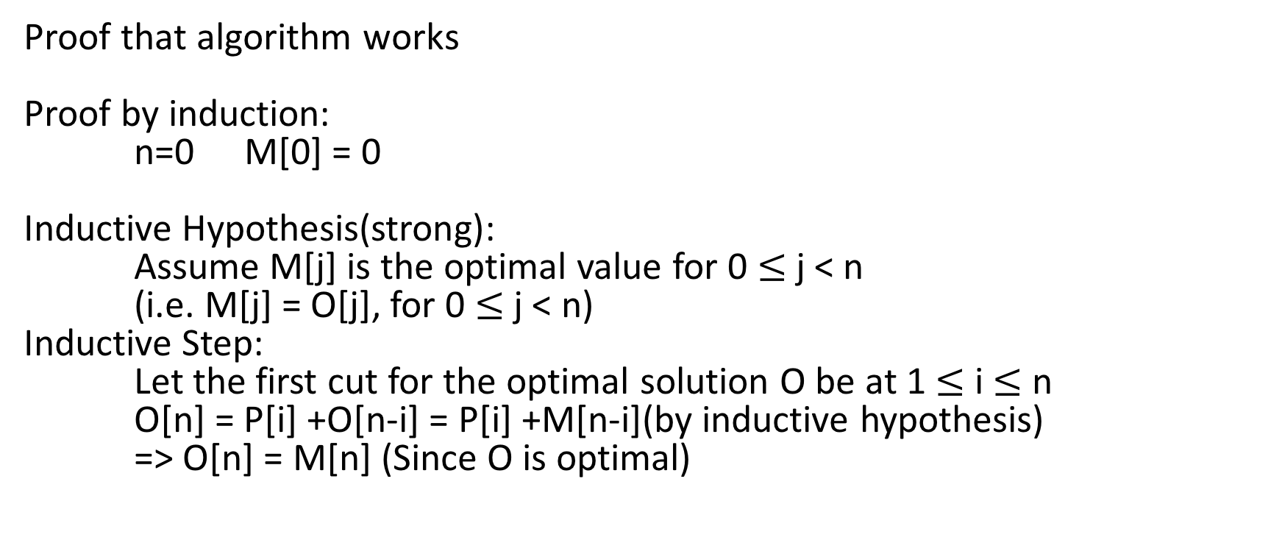
Example 2 (continued)
Proof that algorithm works
Proof by induction:
n=0 M[0] = 0
Inductive Hypothesis(strong):
Assume M[j] is the optimal value for 0 $≤$ j < n
(i.e. M[j] = O[j], for 0 $≤$ j < n)
Inductive Step:
Let the first cut for the optimal solution O be at 1 $≤$ i $≤$ n
O[n] = P[i] +O[n-i] = P[i] +M[n-i](by inductive hypothesis)
=> O[n] = M[n] (Since O is optimal)

Slide 15
Example 2 (continued)
Step V: Find a way of cutting up the rod optimally
Print_Path(P, n):
(M, S) = Bottom_up_cut_Rod(P, n)
while n > 0:
print S[n]
n = n – S[n]

Slide 16
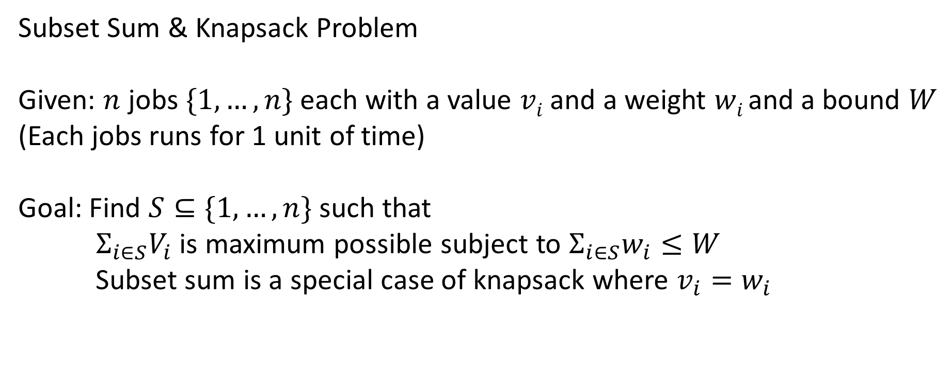
Example 3
Subset Sum & Knapsack Problem
Given: $n$ jobs $\{1, …,n\}$each with a value $vi$ and a weight $wi$and a bound $W$
(Each jobs runs for 1 unit of time)
Goal: Find $S⊆\{1,…,n\}$ such that
$Σ_{i∈S}V_{i}$ is maximum possible subject to $Σ_{i∈S}w_{i}≤W$
Subset sum is a special case of knapsack where $v_{i}=w_{i}$

Slide 17

Example 3 (continued)
Let $Οn$ be an optimal solution and $OPT(n)$ be its value
$OPT\left(n\right)=w_{n}+OPT\left(n−1\right)$
wrong!

Slide 18

Example 3 (continued)
To take care of the constraint
$OPT\left(n, W\right)$
$If n∉Ο_{n}:OPT\left(n, W\right)=OPT\left(n−1, W\right)$
$If n∈Ο_{n}:OPT\left(n, W\right)=w_{n}+OPT\left(n−1, W−w_{n}\right)$

Slide 19
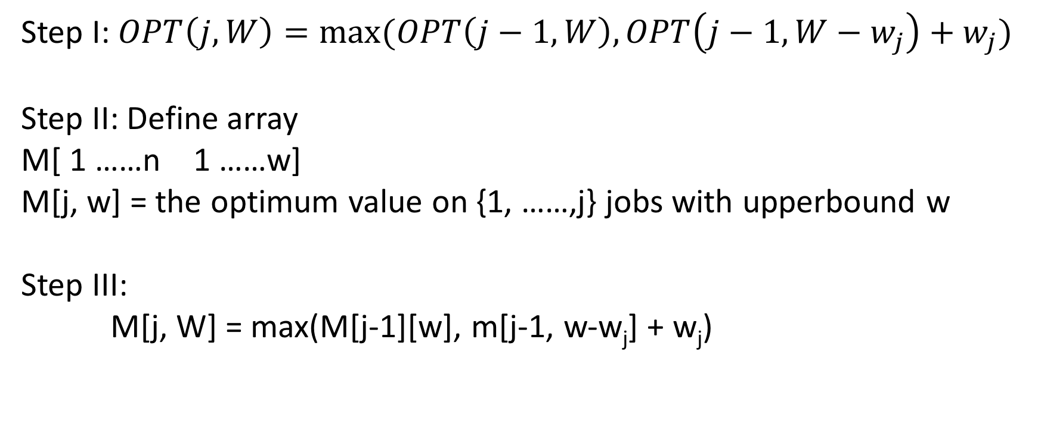
Example 3 (continued)
Step I: $OPT\left(j, W\right)=\max{(OPT\left(j−1, W\right), OPT\left(j−1, W−w_{j}\right)+w_{j})}$
Step II: Define array
M[ 1 ……n 1 ……w]
M[j, w] = the optimum value on {1, ……,j} jobs with upperbound w
Step III:
M[j, W] = max(M[j-1][w], m[j-1, w-w_{j}] + w_{j})

Slide 20
Example 3 (continued)
Step IV:
Subset_sum(n, W):
Define M[0……n 0……W]
M[0,w] = 0 for w = 0, ……,W
for j = 1 to n:
for w=1 to W:
if w < w_{j} then
M[j,w] = M[j-1, w]
else
M[j, w] = max(M[j-1, w], M[j-1, w-w_{j}]+w_{j})
End
Return M[n,w]

Slide 21
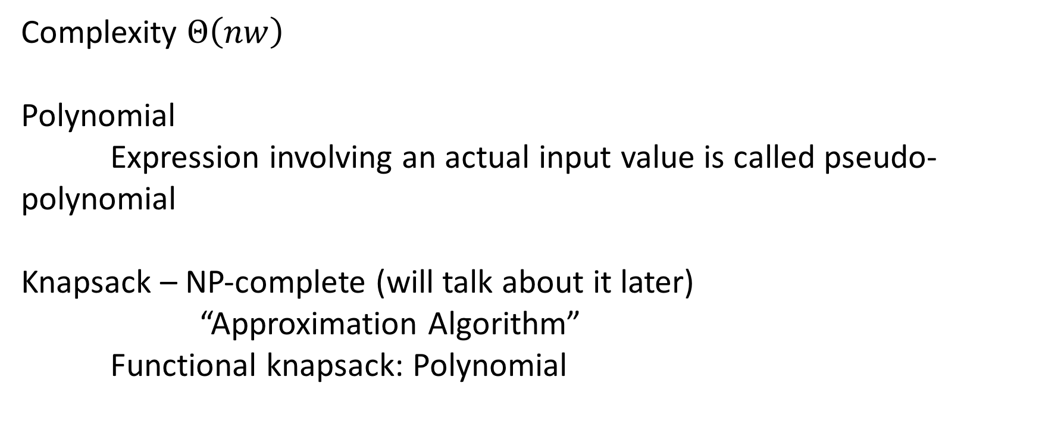
Example 3 (continued)
Complexity $Θ\left(nw\right)$
Polynomial
Expression involving an actual input value is called pseudo-polynomial
Knapsack – NP-complete (will talk about it later)
“Approximation Algorithm”
Functional knapsack: Polynomial

Slide 22

Example 3 (continued)
Step V: Actual Solution
Run through M[j, w] and figure out if j was in the schedule or not
Time complexity: $Θ(n)$

Slide 23
Example 4: Largest Common Subsequence Problem
Given: Two sequences
X = <x₁, x₂, …., x_{n}>
Y = <y₁, y₂, …., y_{n}>
Goal: Find out a subsequence that is common to both x and y, and that has the maximum possible length
E.X. X = <5, 10, 13, 12, 11>
Y = <6, 10, 13, 7, 5, 11>
<10, 13> is a common subsequence of X and Y
<10, 13, 11> is a longest common subsequence of X and Y

Slide 24

Example 4 (continued)
Solution:
Step I:
Case I: X_{m}=Y_{n}
OPT(X, Y) = OPT(<x₁, …, x_{m-1}>, <y₁, …, y_{n-1}) + x_{m}
Case II: X_{m}$≠$Yn
OPT(X_{1…m}, Y_{1…n}) = max(OPT(X_{1…m-1}, Y_{1…n}), OPT(X_{1…m}, Y_{1…n-1}))

Slide 25
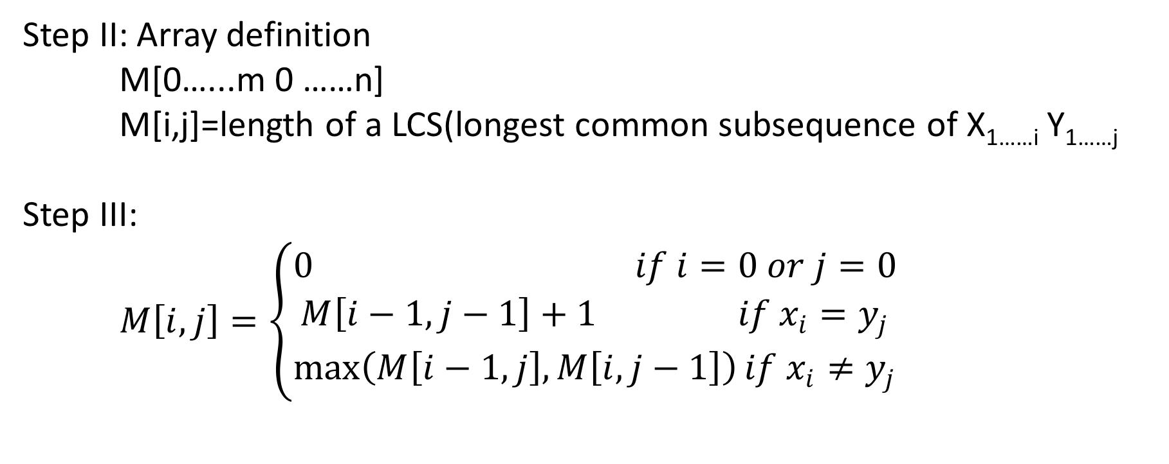
Example 4 (continued)
Step II: Array definition
M[0…...m 0 ……n]
M[i,j]=length of a LCS(longest common subsequence of X_{1……i} Y_{1……j}
Step III:
$M\left[i,j\right]=\left\{\begin{aligned}0 if i=0 or j=0 \\ M\left[i−1, j−1\right]+1 if x_{i}=y_{j} \\ \max\left(M\left[i−1, j\right], M\left[i, j−1\right]\right)if x_{i}≠y_{j}\end{aligned}\right.$

Slide 26
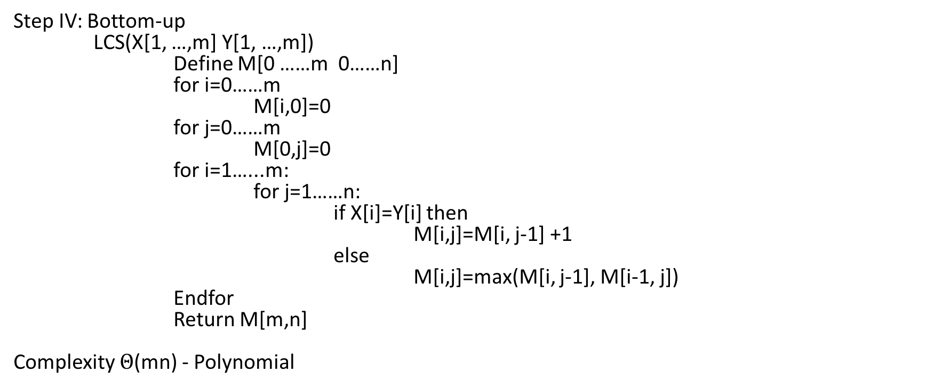
Example 4 (continued)
Step IV: Bottom-up
LCS(X[1, …,m] Y[1, …,m])
Define M[0 ……m 0……n]
for i=0……m
M[i,0]=0
for j=0……m
M[0,j]=0
for i=1…...m:
for j=1……n:
if X[i]=Y[i] then
M[i,j]=M[i, j-1] +1
else
M[i,j]=max(M[i, j-1], M[i-1, j])
Endfor
Return M[m,n]
Complexity $Θ$(mn) - Polynomial

Slide 27
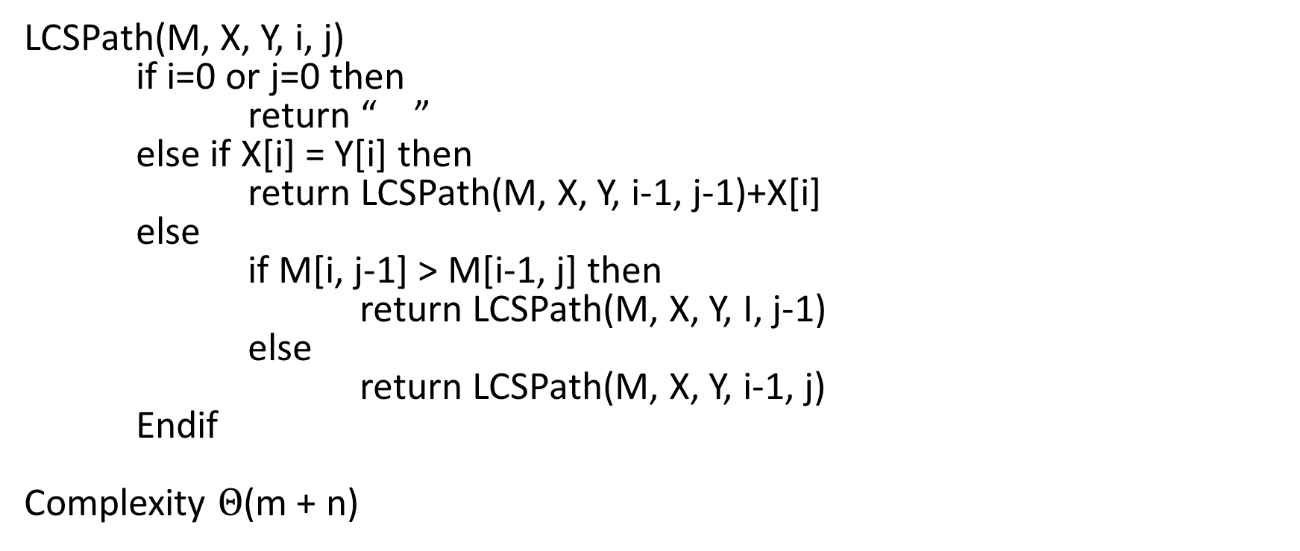
Example 4 (continued)
LCSPath(M, X, Y, i, j)
if i=0 or j=0 then
return “ ”
else if X[i] = Y[i] then
return LCSPath(M, X, Y, i-1, j-1)+X[i]
else
if M[i, j-1] > M[i-1, j] then
return LCSPath(M, X, Y, I, j-1)
else
return LCSPath(M, X, Y, i-1, j)
Endif
Complexity $Θ$(m + n)

